Slide 1
Promptable Pathology
Zero-Shot Medical Image Segmentation
CSCE 689 Fall 2025 | Shubham Mhaske

Slide 2
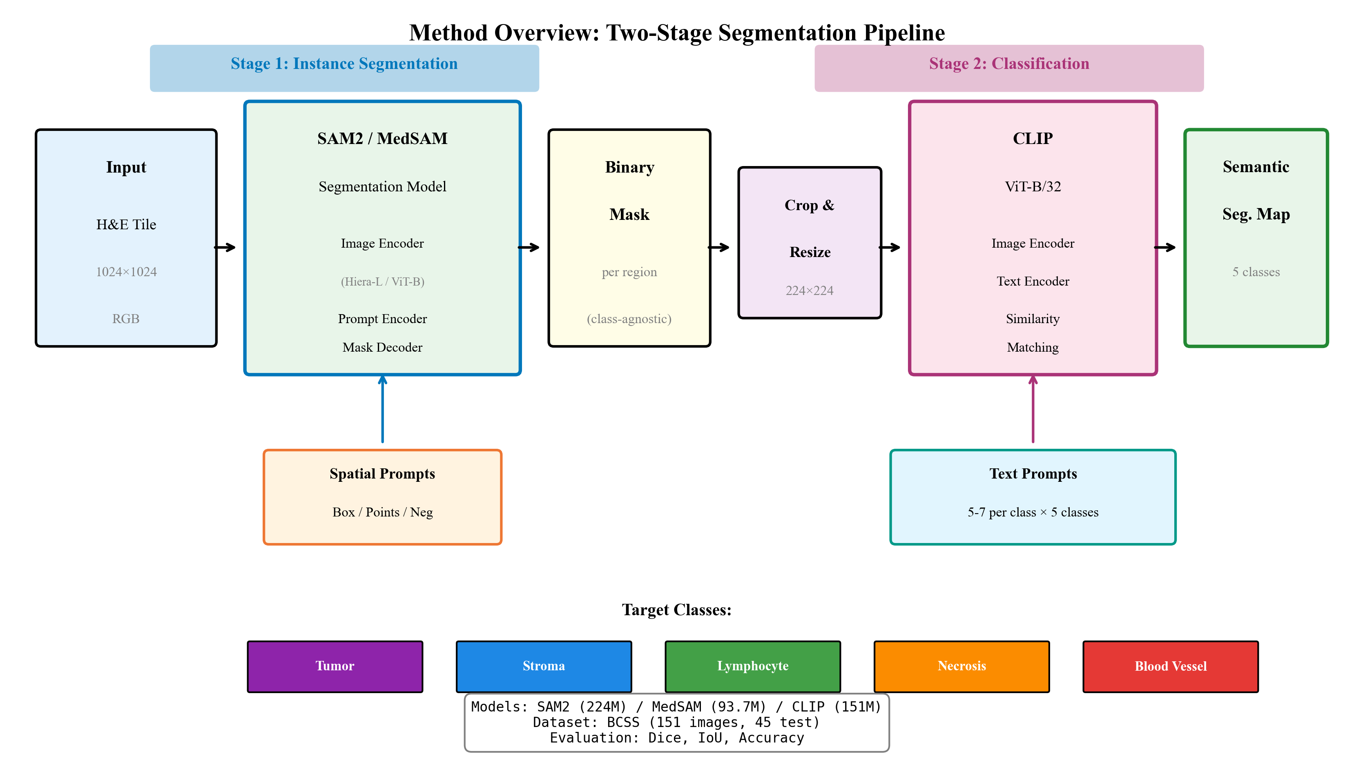
Two-Stage Pipeline: SAM2 + CLIP
• Modular Two-Stage Design: SAM2 (Segmentation) + CLIP (Classification)
• User provides prompts (points/boxes) → System segments and classifies tissue regions
• Dataset: BCSS (151 images, 5 tissue classes: tumor, stroma, lymphocyte, necrosis, blood vessel)

Slide 3
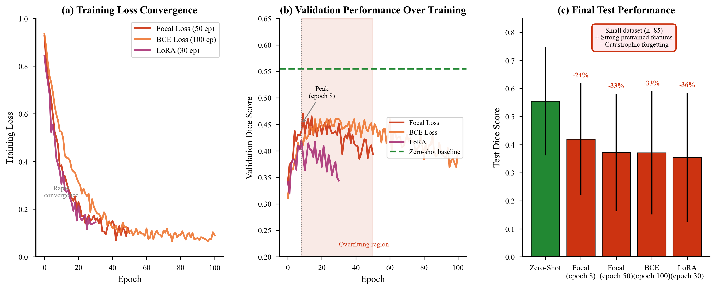
Why Finetuning Failed
• Tested: PathSAM2+CTransPath (0.37), LoRA adapters (0.27-0.36), Focal Loss (0.37)
• Linear Probe: Logistic Regression on CLIP features (40.4%) — still < Zero-Shot (44.4%)
• Zero-Shot SAM2 (0.55) outperforms ALL finetuned models by 30-50%

Slide 4
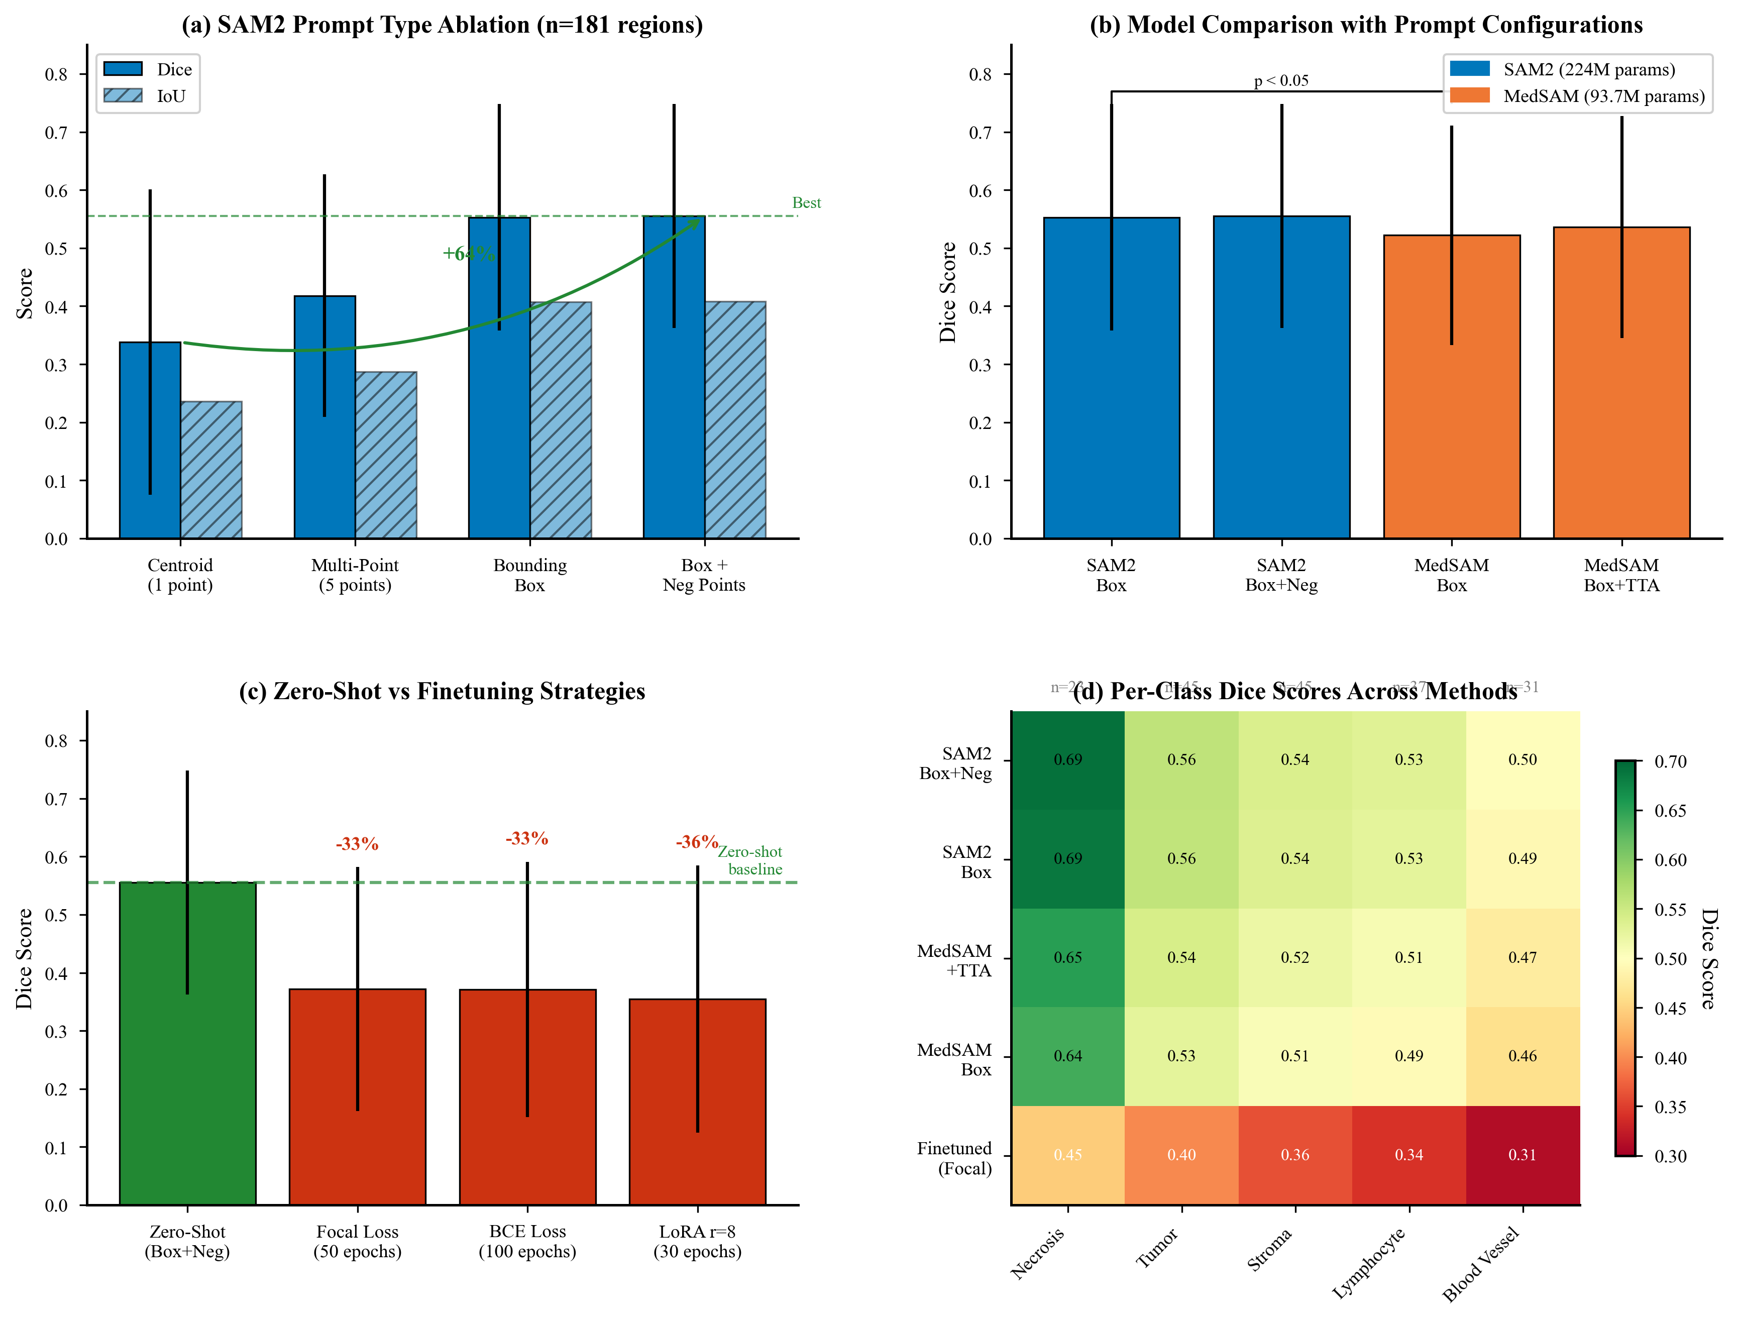
Prompt Strategy Comparison
• Box prompts: 0.55 Dice vs Centroid: 0.34 (+64% improvement)
• TTA with Prompt Rotation: Geometrically transforming box coords to match augmentations (+2%)
• Ours (0.555) beats fully supervised MedSAM ViT-B Model (0.536)

Slide 5
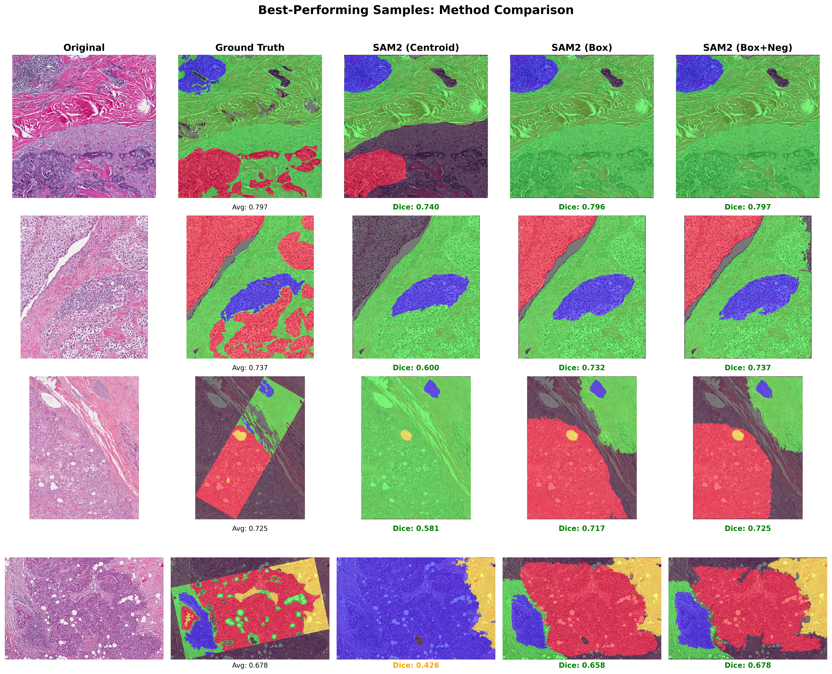
Visual Comparison Across Methods
• Best samples: Ours (Box+Neg) achieves tight boundaries vs blob-like point prompts
• Centroid prompts fail on multi-region classes; Box captures full extent
• Negative points suppress background bleeding in complex tissue interfaces

Slide 6
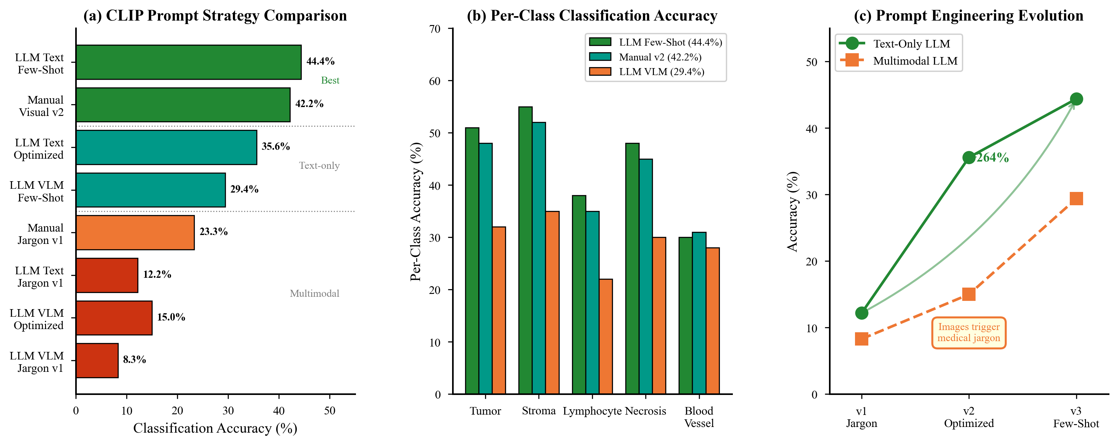
CLIP Prompt Engineering
• V1 'Medical Jargon' (12%) → V3 'Gemini Few-Shot' (44%) = +264% improvement
• Key: Translate pathology terms to visual descriptors CLIP understands
• Also tested: PLIP (27%), Ensembles (31%) - CLIP alone is best

Slide 7
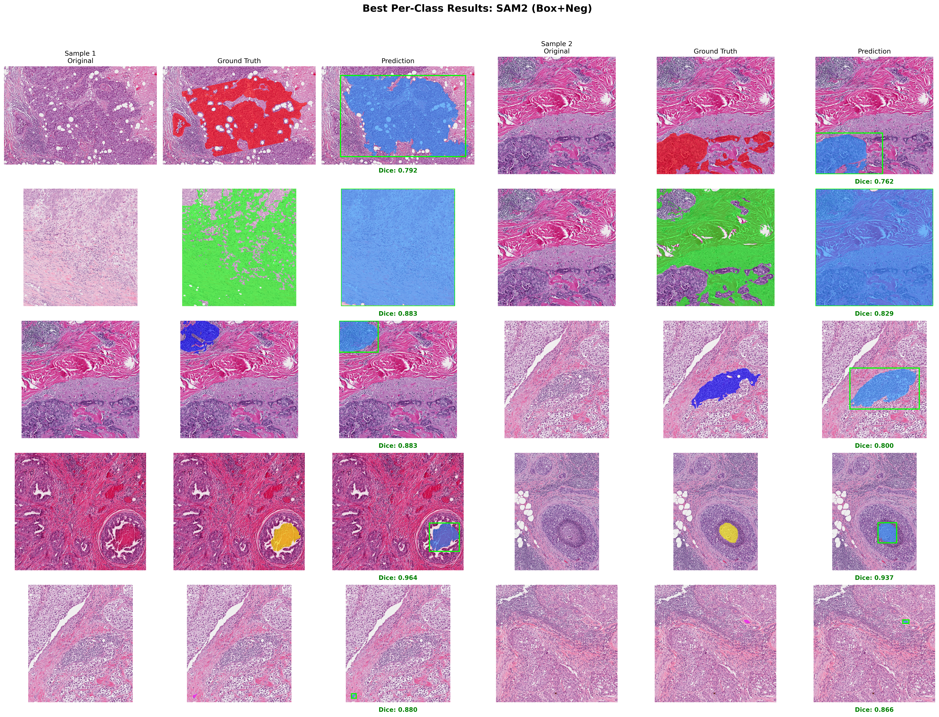
Class Imbalance & Performance
• Best: Tumor (0.70 Dice), Stroma (0.60) | Worst: Lymphocytes (0.25), Blood (0.42)
• Class imbalance (Stroma=54%, Lymphocytes=3%) drives performance gap
• Rare classes need domain-specific prompts or targeted augmentation

Slide 8
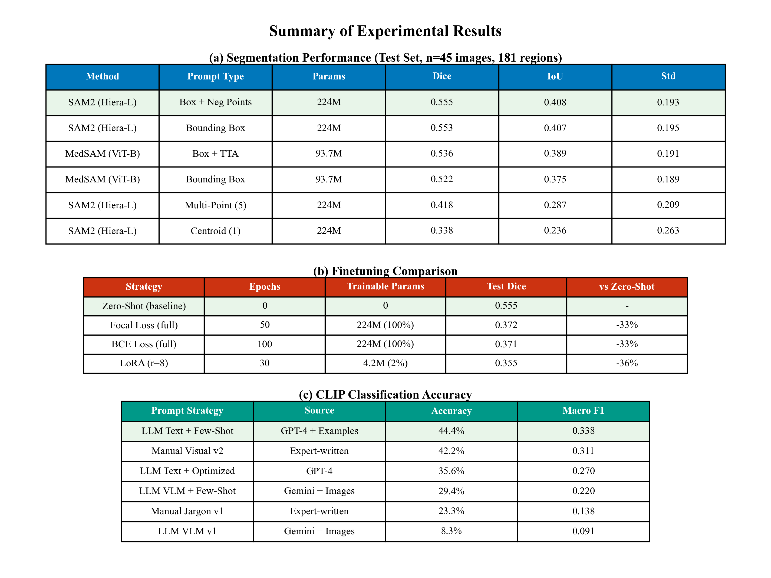
Key Findings & Takeaways
✓ Key Finding:
For small medical datasets (N<100), Prompt Engineering > Model Finetuning
✓ Segmentation:
Zero-Shot SAM2 + Box+Neg: 0.555 Dice (beats finetuned MedSAM 0.536)
✓ Classification:
CLIP + Gemini Few-Shot Prompts: 44.4% Accuracy (+264% vs jargon)
✓ Insight:
50+ failed experiments → Simple zero-shot with good prompts wins

